Slide 1
Databases
Seminar 1

Slide 2
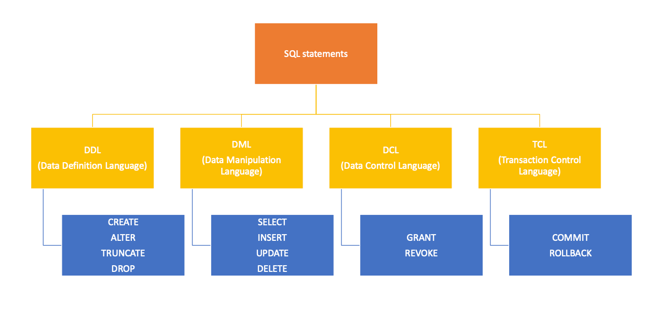
SQL queries

Slide 3
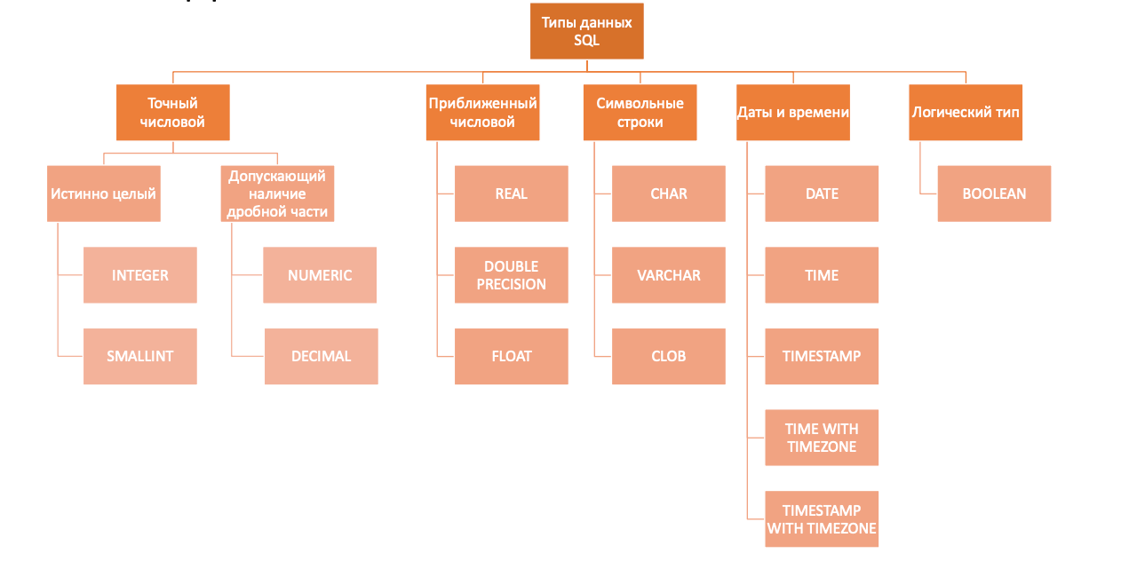
SQL datatypes

Slide 4
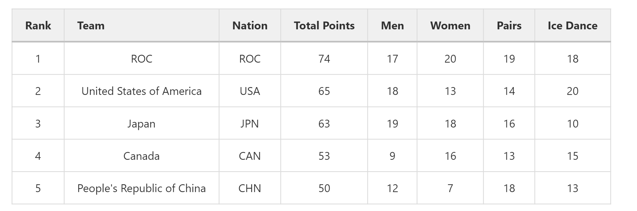
Task 1

Slide 5
Query structure
SELECT [DISTINCT] select_item_comma_list -- list of answer columns
FROM table_reference_comma_list -- list of tables
[WHERE conditional_expression] -- conditions for filtration, one can use AND / OR / NOT
[GROUP BY column_name_comma_list] -- grouping condition
[HAVING conditional_expression] -- conditions for filtration after the grouping
[ORDER BY order_item_comma_list]; -- list of fields for sorting

Slide 6
Order of execution
FROM → WHERE → GROUP BY → HAVING → SELECT → ORDER BY

Slide 7
Aggregation functions
When grouping, the SELECT block may contain either attributes by which grouping occurs, or attributes that are supplied as input to aggregating functions. There are 5 standard aggregation functions in SQL. When executing a function call, the special value NULL, which denotes a missing value, is not taken into account.

Slide 8
Aggregation functions
count() – number of records with a known value. If you need to count the number of unique values, you can use count(DISTINCT field_nm)
max() - the largest of all selected field values
min() - the smallest of all selected field values
sum() - the sum of all selected field values
avg() - average of all selected field values

Slide 9
Special functions
IN - belonging to a specific set of values:
X IN (a1, a2, ..., an) ≣ X = a1 or X = a2 or ... or X = an
BETWEEN - belonging to a certain range of values:
X BETWEEN A AND B ≣ (X >= A and X <= B) or (X <= A and X >= B)
LIKE - text satisfaction to the pattern: X LIKE '0%abc_0', where _ is exactly 1 character, and % is any sequence of characters (including zero length).
SIMILAR TO - matching text to SQL regular expression (POSIX-like):
'abc' SIMILAR TO '%(b|d)%'

Slide 10
Many conditions
SELECT
IF number = 0 THEN
'zero'
ELSIF number > 0 THEN
'positive'
ELSIF number < 0 THEN
'negative'
ELSE
'NULL'
END IF AS number_class
FROM
numbers

Slide 11
Many cases
SELECT
CASE
WHEN number = 0 THEN
'zero'
WHEN number > 0 THEN
'positive'
WHEN number < 0 THEN
'negative'
ELSE
'NULL'
END CASE AS number_class
FROM
numbers

Slide 12
Unique values
SELECT
count(DISTINCT ON department_nm)
FROM
salary;

Slide 13
Dates in PostgreSQL
data type | description | example | output
TIMESTAMP | date and time | TIMESTAMP '2023-04-10 10:39:37' | 2023-04-10T10:39:37
DATE | date (no time) | DATE '2023-04-10 10:39:37' | 2023-04-10
TIME | time (no day) | TIME '2023-04-10 10:39:37' | 10:39:37
INTERVAL | interval between two date/times | TIME '2023-04-10 10:39:37' | 1 day, 2:00:10

Slide 14
Dates in PostgreSQL
Today's date can be found like this: NOW() (timestamp), CURRENT_DATE (date), LOCALTIME (current time)
DATE_TRUNC(‘[interval]’, time_column) - allows you to round to month, year, date, etc.
Example: DATE_TRUNC('month', DATE '2023-04-10') will return DATE '2023-04-01'
DATE_TRUNC('day', TIMESTAMP '2023-04-10 10:39:37') will return TIMESTAMP '2023-04-10 00:00:00'
TO_CHAR([date type], [pattern]) - allows you to format the date into a string using a pattern
Example: TO_CHAR(DATE '2023-04-10', 'YY') will output the last 2 digits of the year 23

